Slide 1
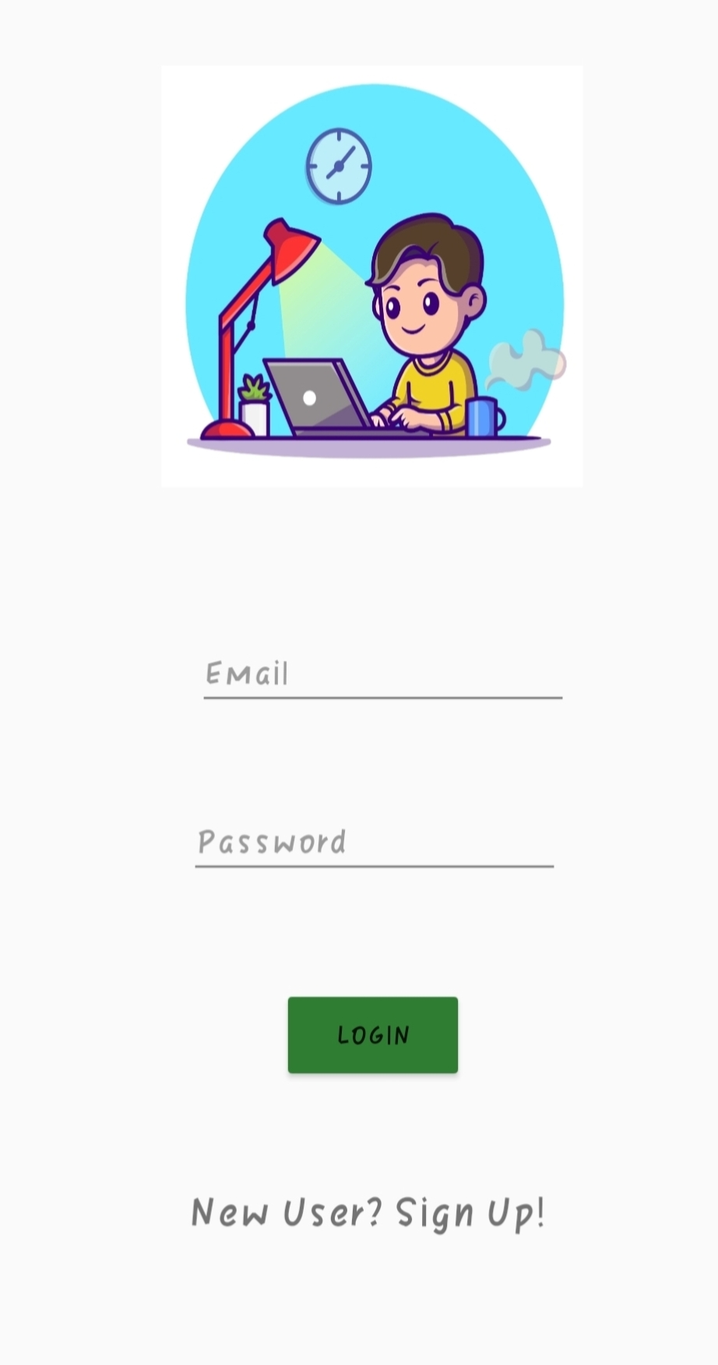
Csn-254 Project: Assessor
Team ASSESSOR – 5
19114016 - AVVARI SREEDHAR
19114051 - Rohith mamidi
19114062 - P SASI PREETHAM
19114066 - PUTTA JAIDEEP
19115016 - AKANTI GIRI NANDAN

Slide 2
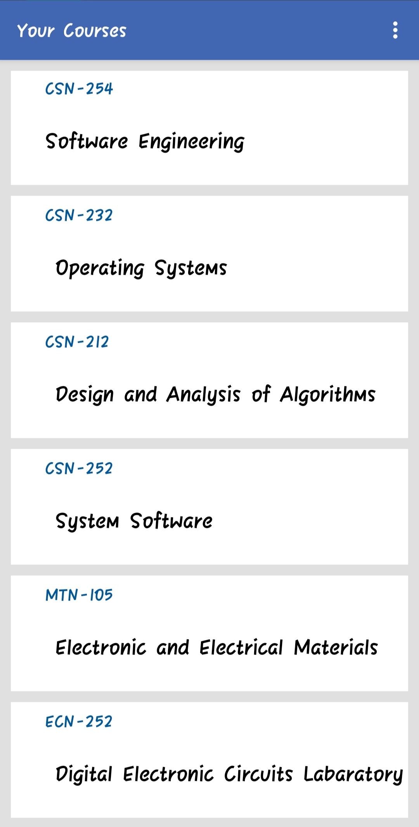
Course page
In this page, the courses in which the student is enrolled will be displaced in list format.

Slide 3
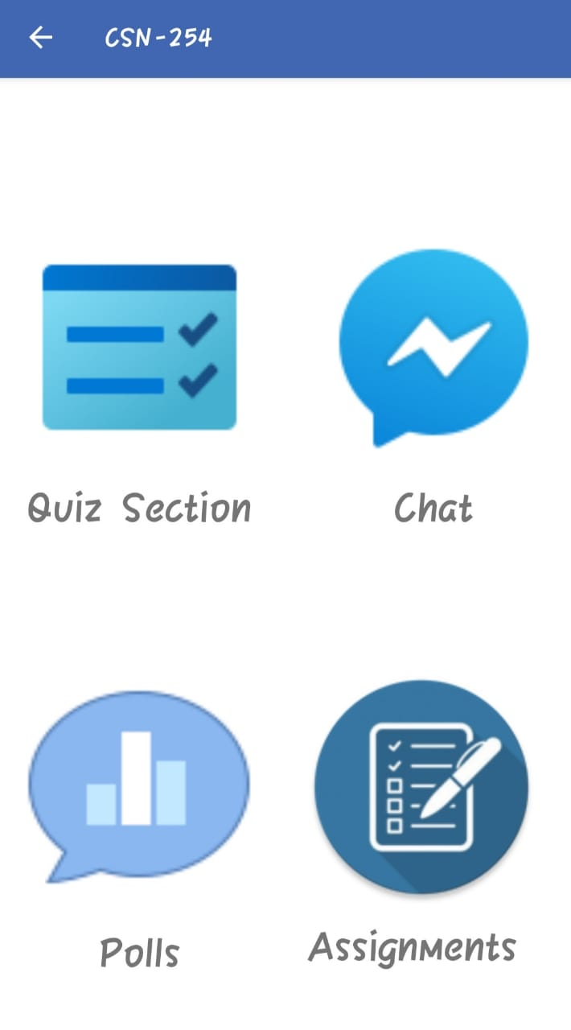
Course functions
Chat Box
Assignment
Polling
Quiz

Slide 4
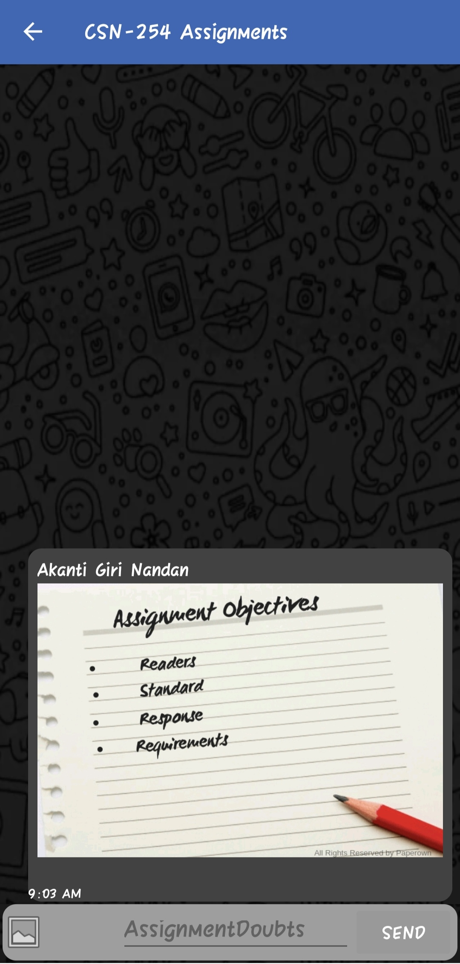
ASSIGNMENT Section
In this section the course administrator will post the assignment in image format for the students to answer
Once the professor posted the images he will change the rules in the firebase such that the students can be able to only post(write) their work but can't see(read) other's submissions before the deadline.
After the deadline, the administrator will change the firebase rules such that all students can see(read) all submissions and the answers uploaded by the professor but cannot post(write) anymore.
Finally the results will be provided by the professor in the chat box if he wiah to do so.

Slide 5
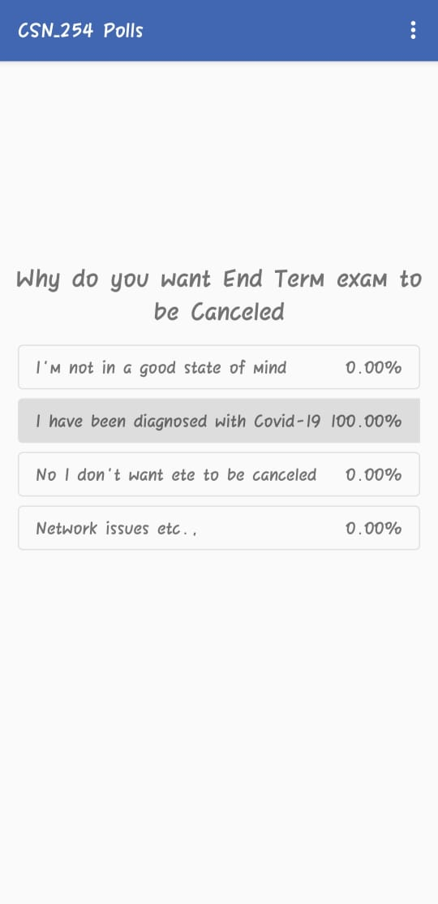
Polling
Polling section is used by the course instructor to know student's choices and understanding by asking students to express their opinion for a question by a simple selection.
Whenever a student votes or chooses an option of his wish, the count of students who chosen the same option is updated and stored.
Student can't attempt the poll twice so that he can't change his opinion by knowing the opinion of the rest.
Only after attempting it, he can refresh and can check the percentage of students voted per question.
Course instructor can anytime clear the responses of all students, in case of any discrepancy .

Slide 6
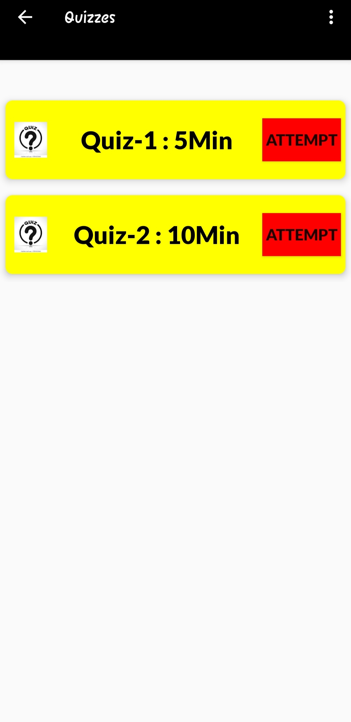
QUIZ SECTION
The Quiz Section is used by the course administrator to conduct quizzes for the course and the students who are enrolled for the course can attempt it.
The quizzes which are created will be displayed in a list and student can attempt the quiz by clicking on the attempt button.
Upon attemption, the questions are displayed and the timer will start which a student can see at the top corner.
The student can submit the quiz by clicking the submit button else, it gets auto-submitted if he uses other application while attempting, or in case of time up.

Slide 7
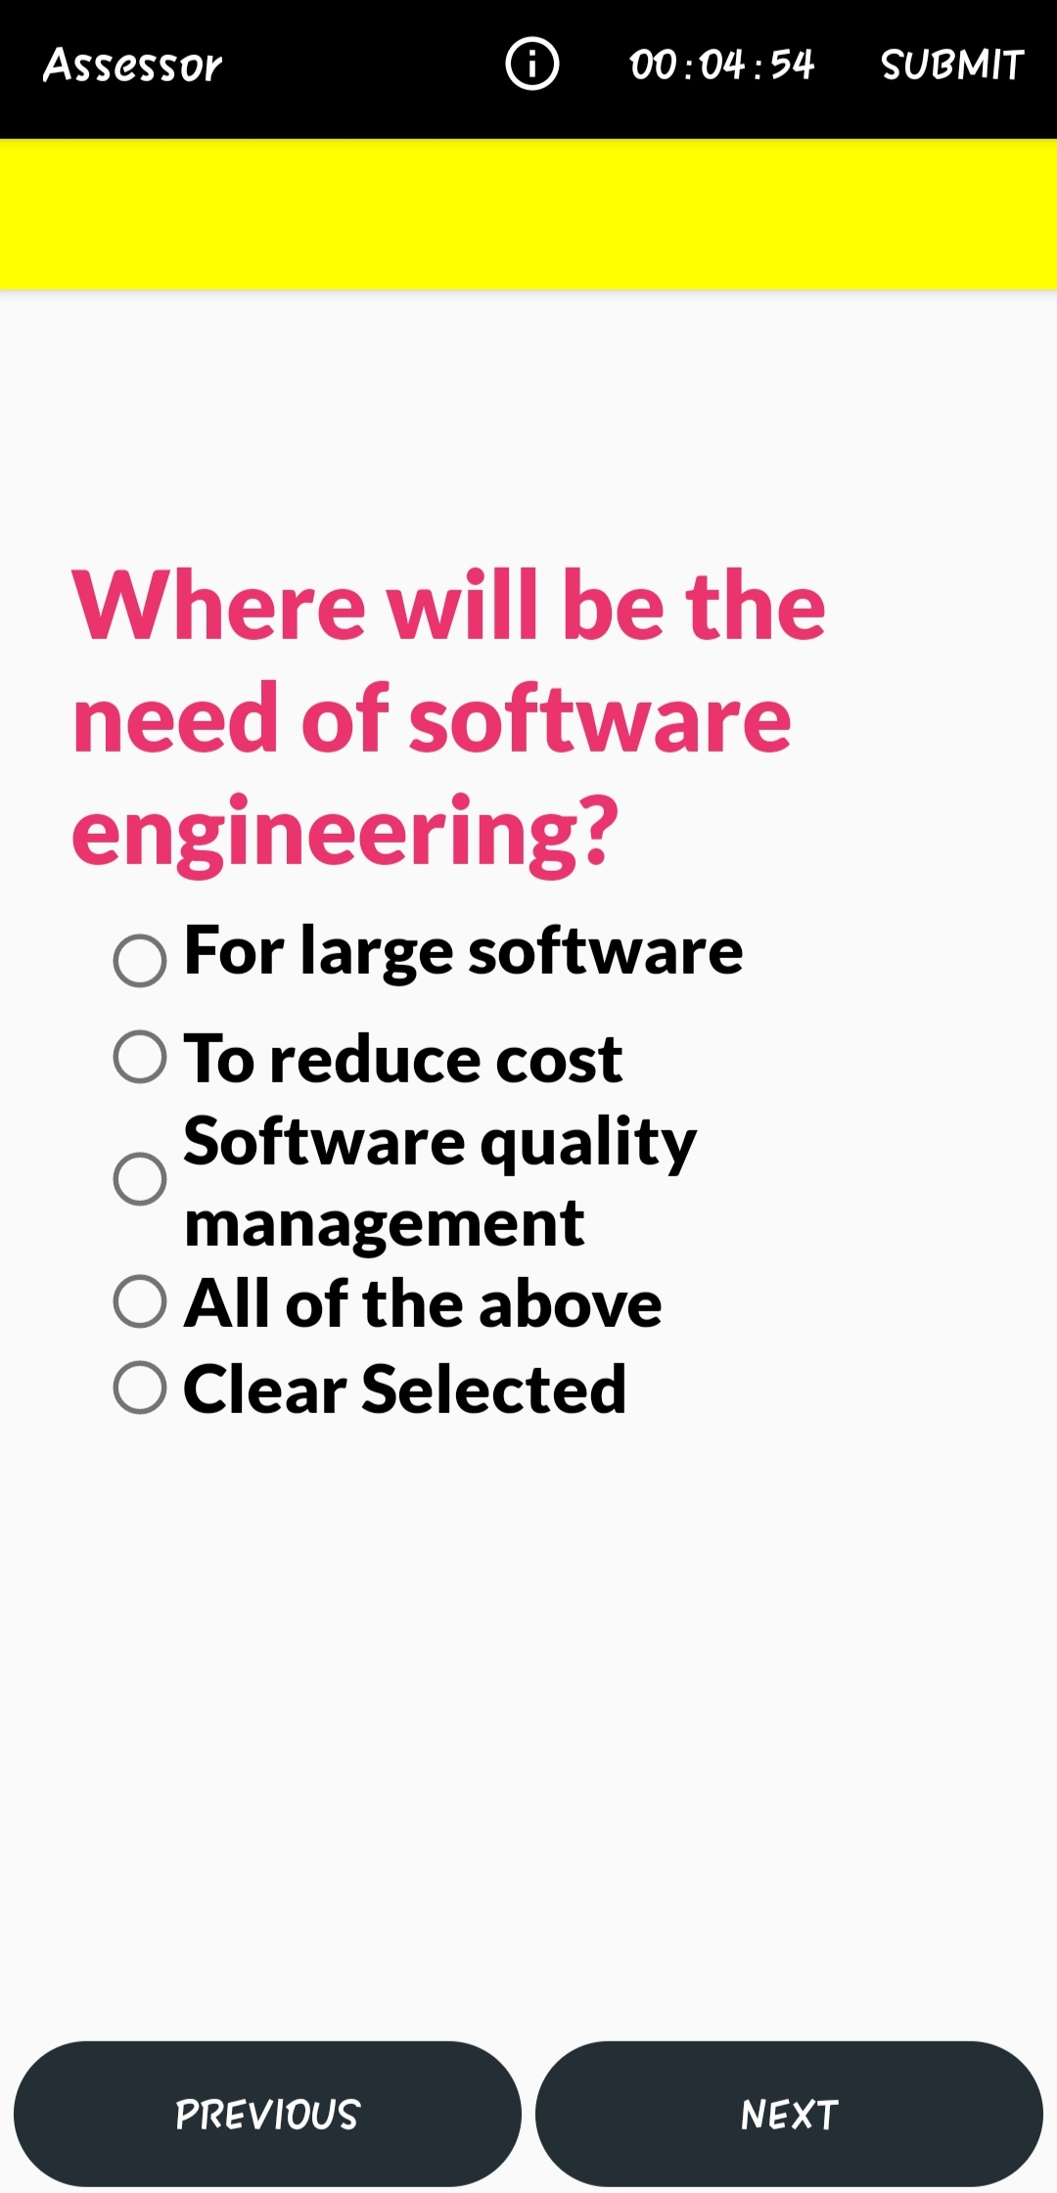
QUIZ SECTION cont.....
The student can navigate through the questions with the help of previous and next buttons at the bottom of the question screen.
The student can obtain the results by clicking the option in the three dots on the right corner of the quiz screen.
The results are saved and uploaded to fire base after the submission where, both the lecturer and student can view the results before the professor clears the data.

Slide 8
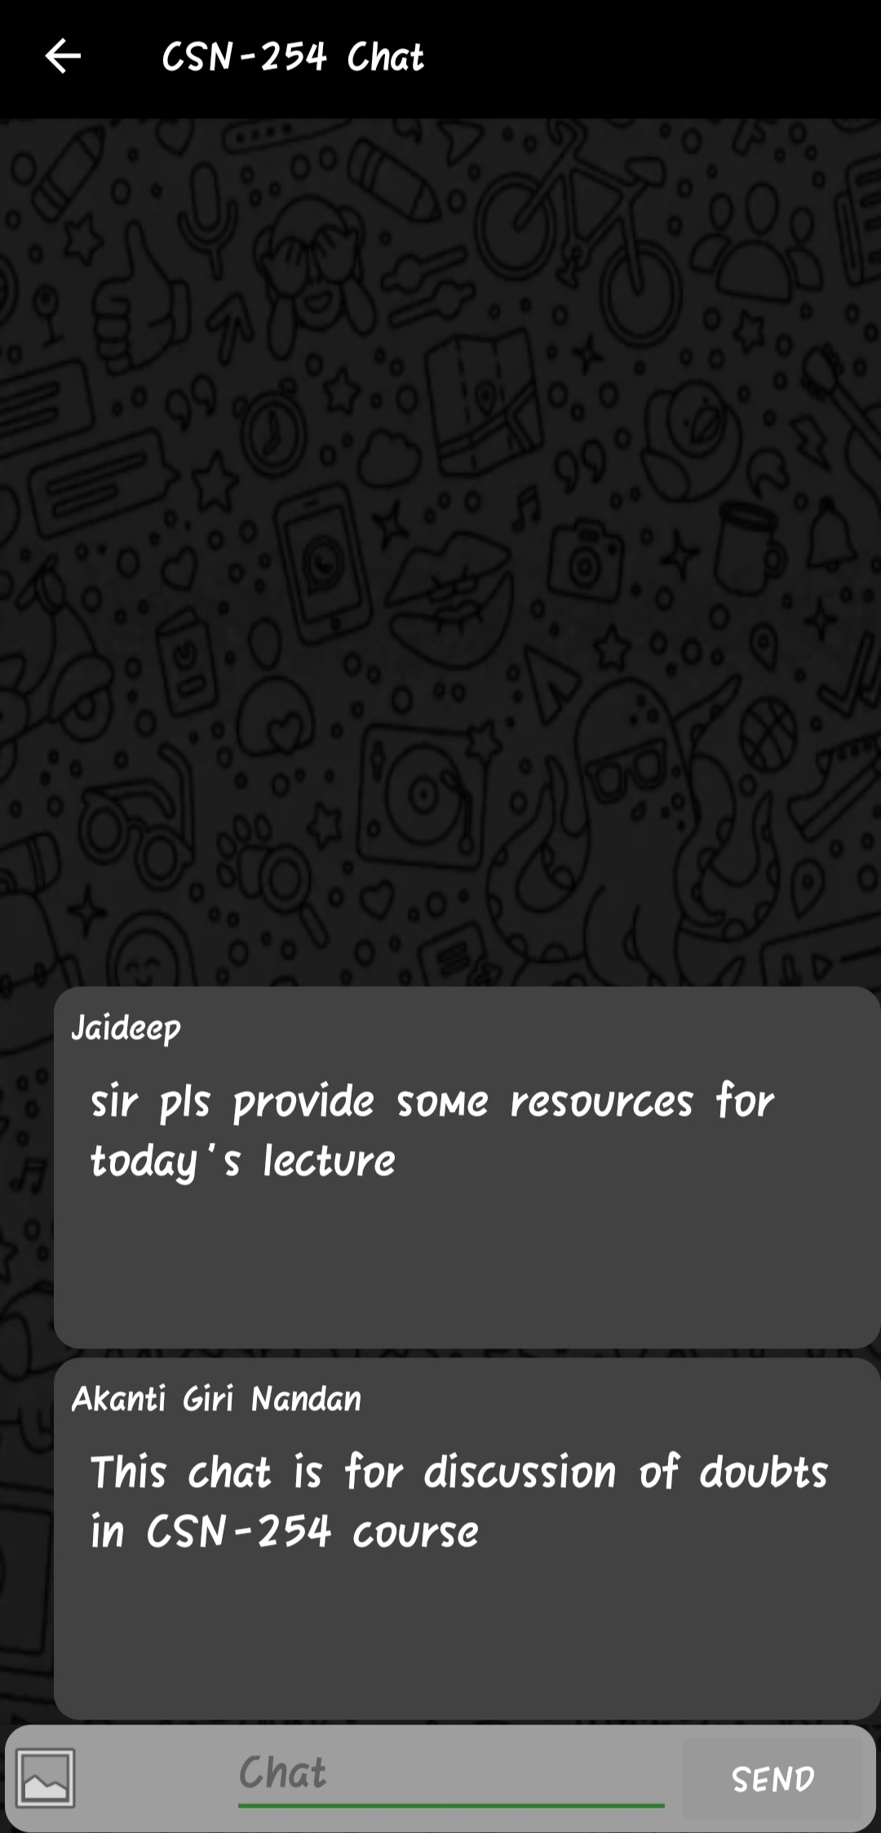
CHAT BOX
The Chat box is used by the course administrator and the students who are enrolled in the course for sharing their doubts and any other discussions held in the course
The message or chat which one enters will get uploaded to the firebase as a string and it will be retrieved from the firebase to all the users who have permission to read the chat.
The user can also send images through this.

Slide 9

Thank You
ASSESSOR
FROM TEAM
- ASSESSOR

